Slide 1
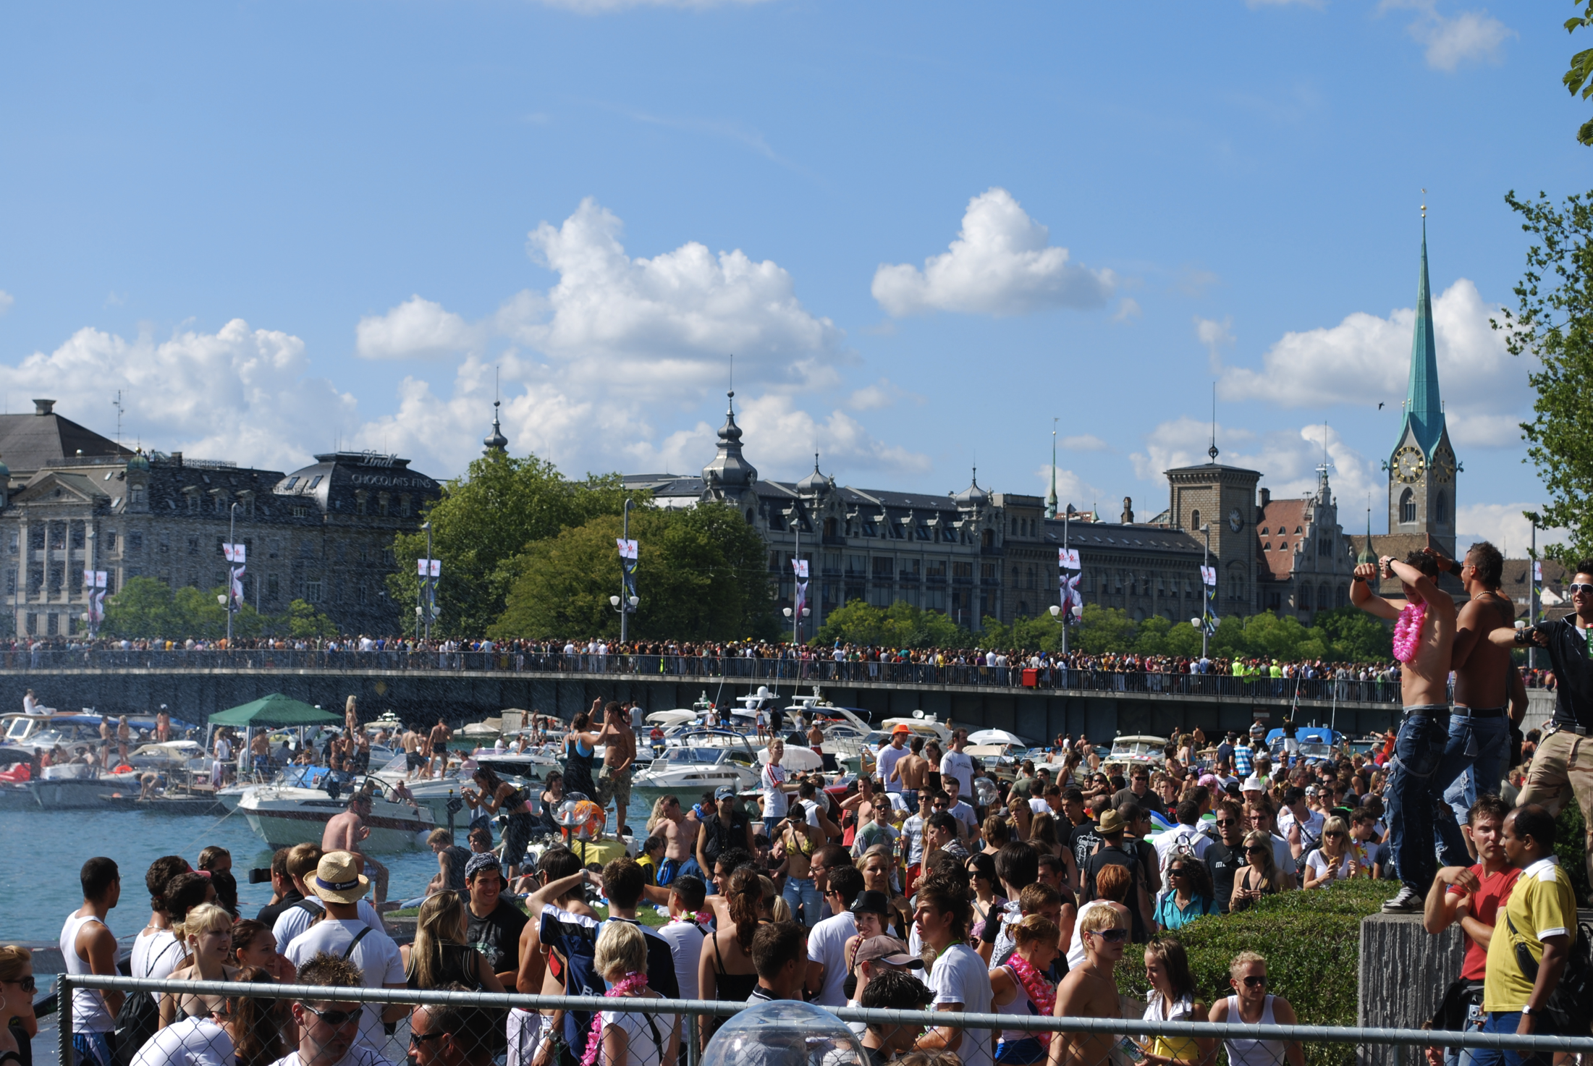
23 September 2017
BSides Zürich
The
Social
Networks
of the
Security Community
Jeroen Massar
jeroen@massar.ch

Slide 2
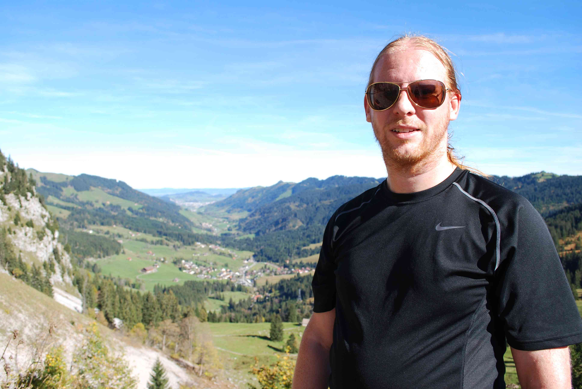
Jeroen Massar
  private:
  https://jeroen.massar.ch & jeroen@massar.ch
  work:
  Massar Networking (independent security & engineering researcher)
  funtime:
  Secluded.ch / Trident Coder ← hat of the day
  Ops-Trust Sysadmin Team
  Before sunset: SixXS Staff

Slide 3
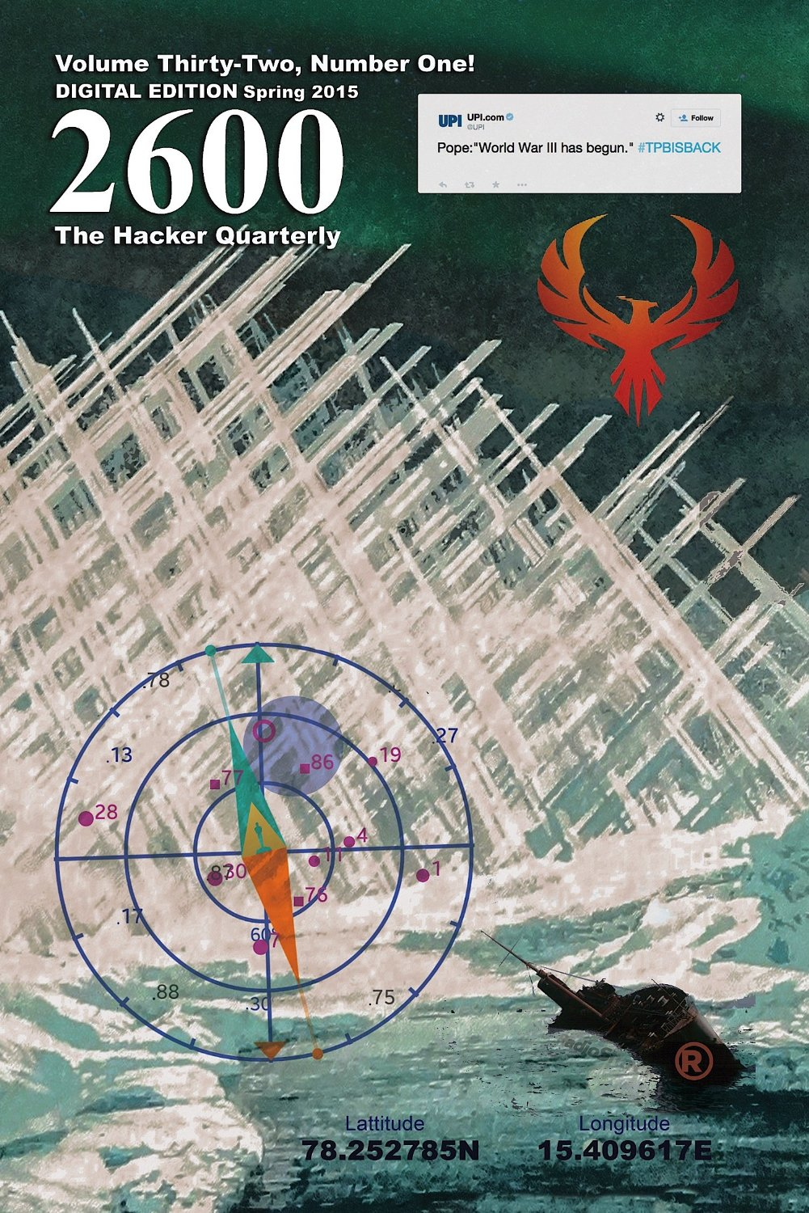
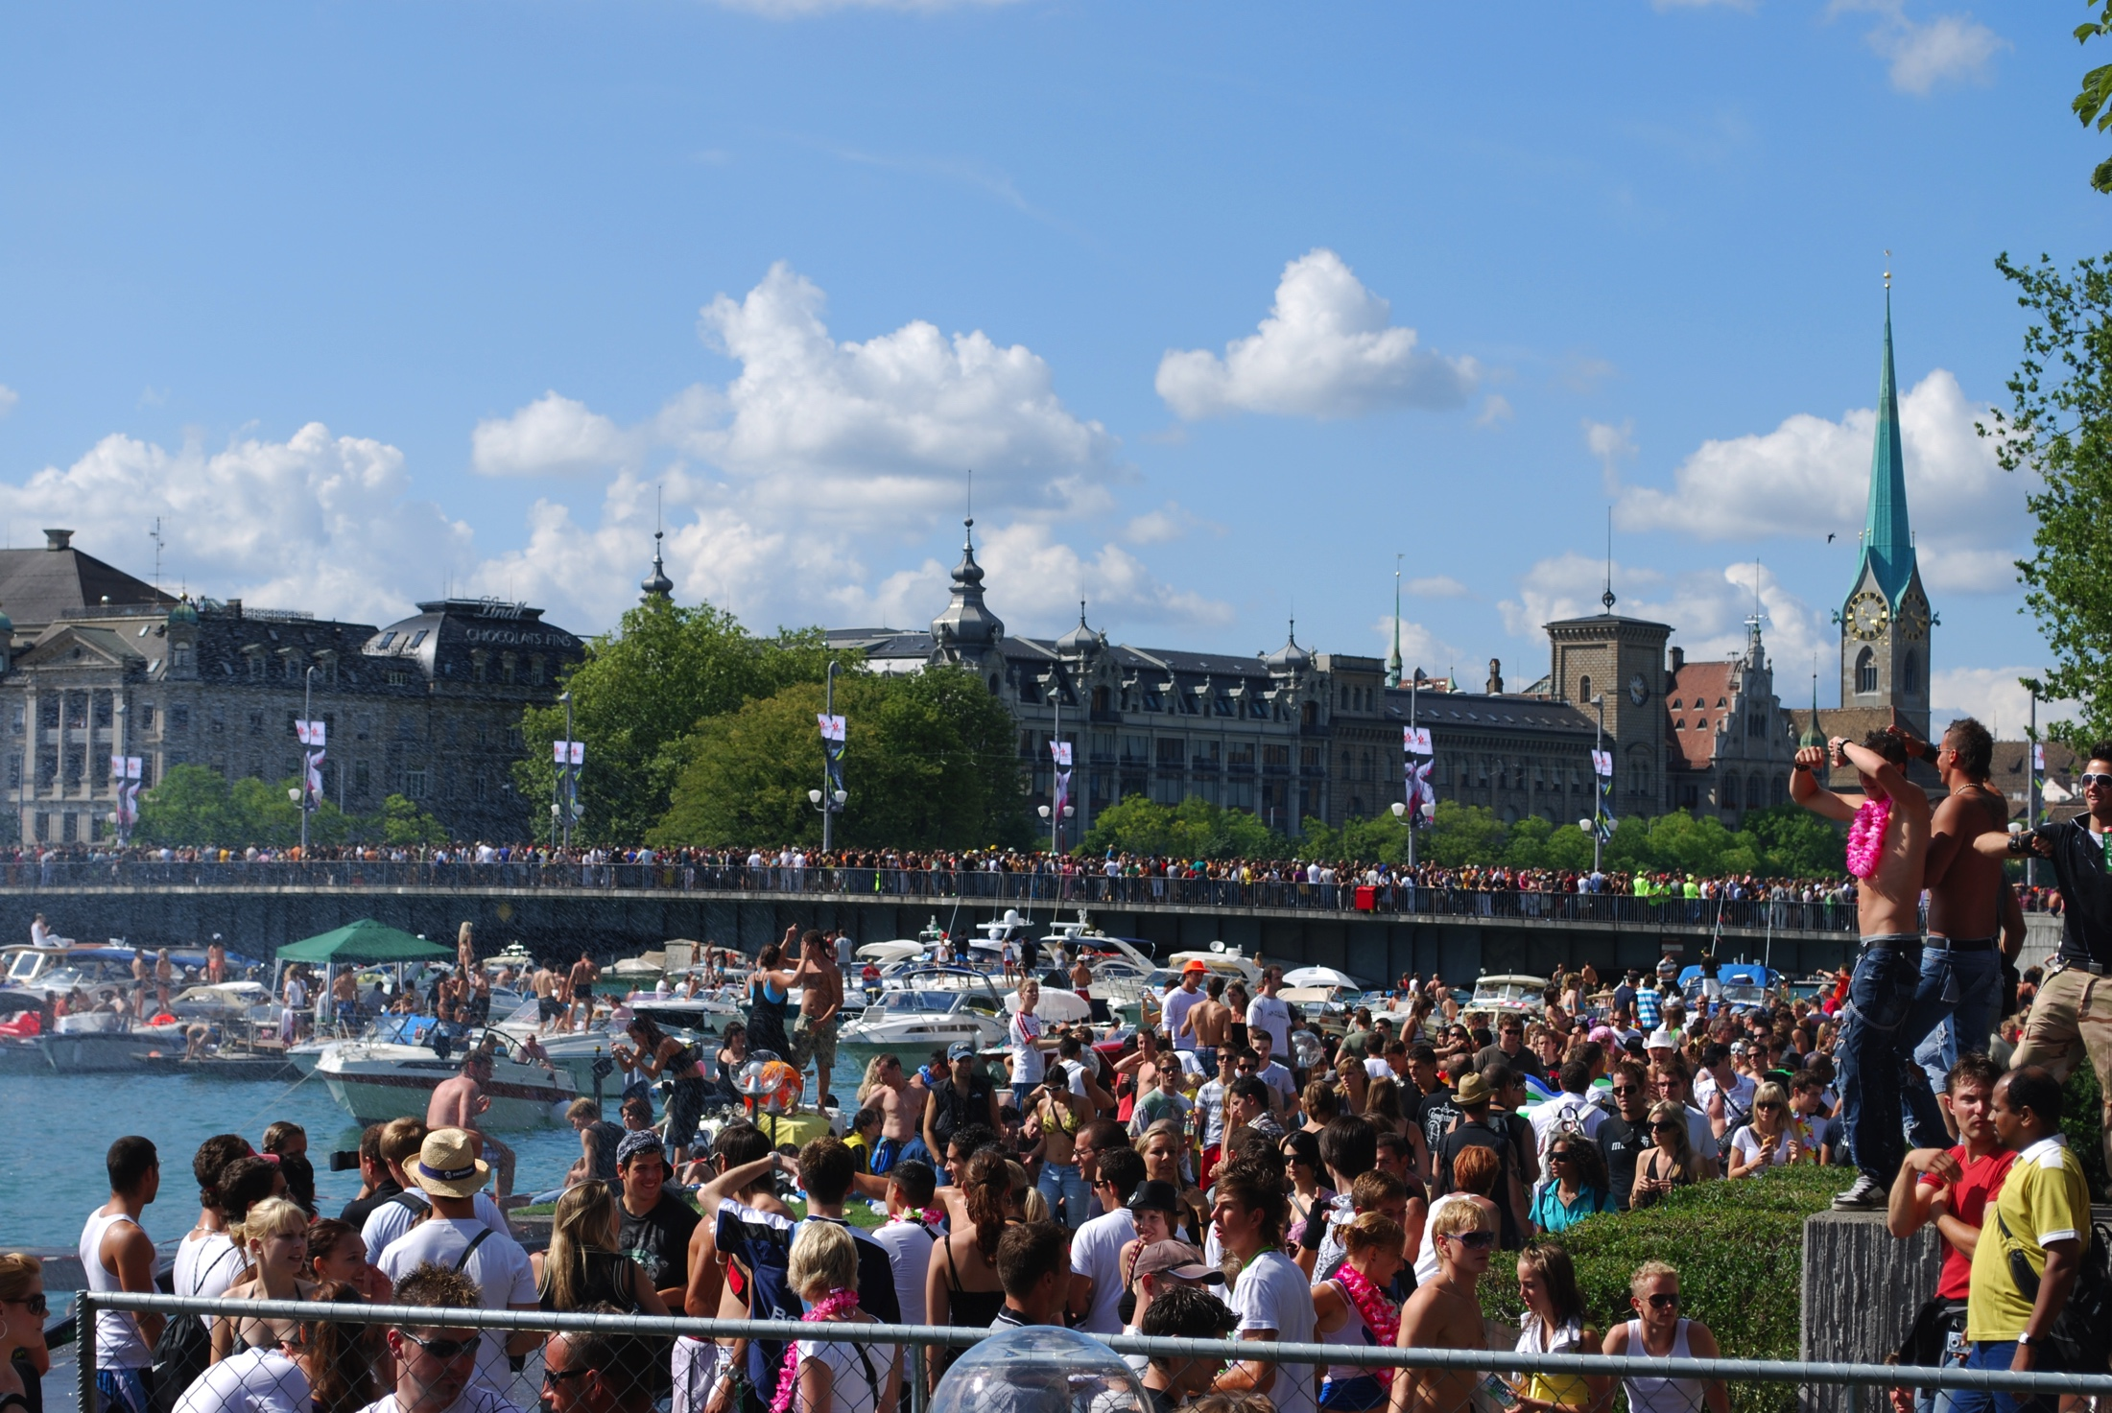
2600

Slide 4



Hacktic
1989 - Galactic Hacker Party (GHP)
1993 - Hacking at the End of the Universe (HEU)
1997 - Hacking In Progress (HIP)
2001 - Hackers At Large (HAL)
2005 - What The Hack (WTH)
2009 - Hacking at Random (HAR)
2013 - Observe. Hack. Make. (OHM)
2017 - Still Hacking Anyway (SHA)

Slide 5

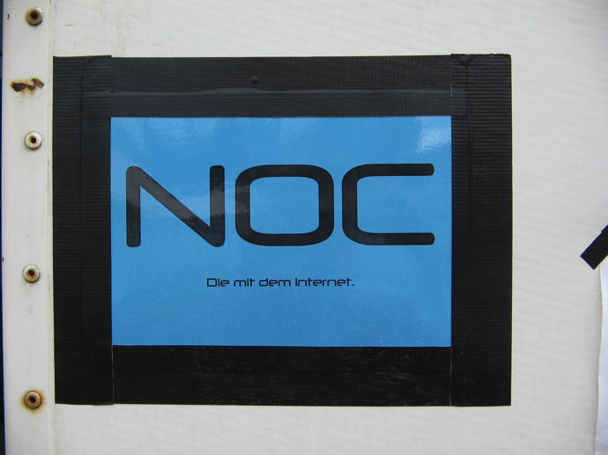
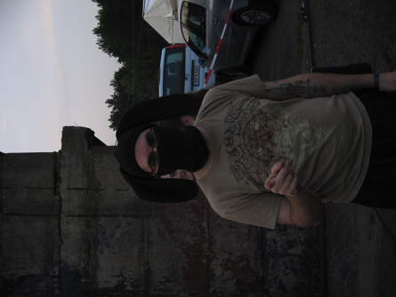
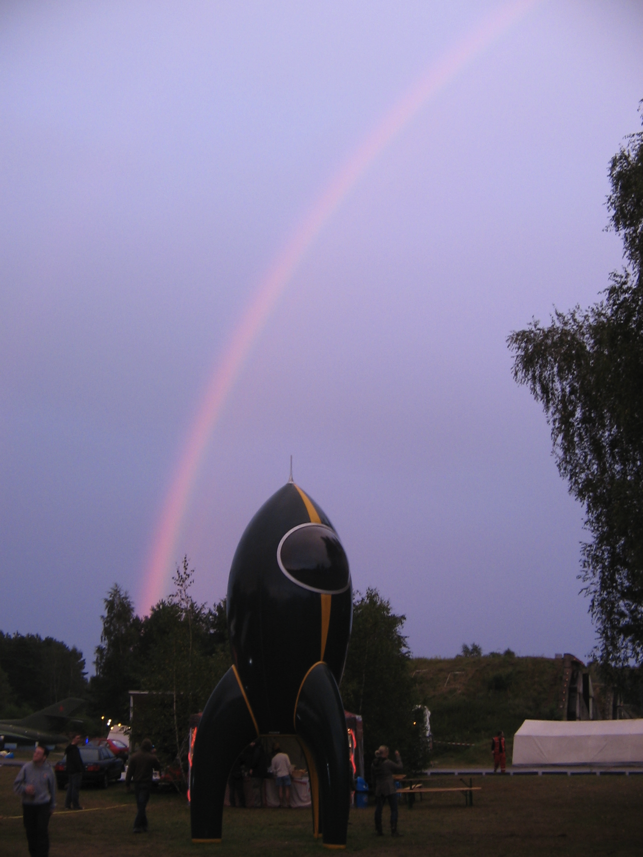
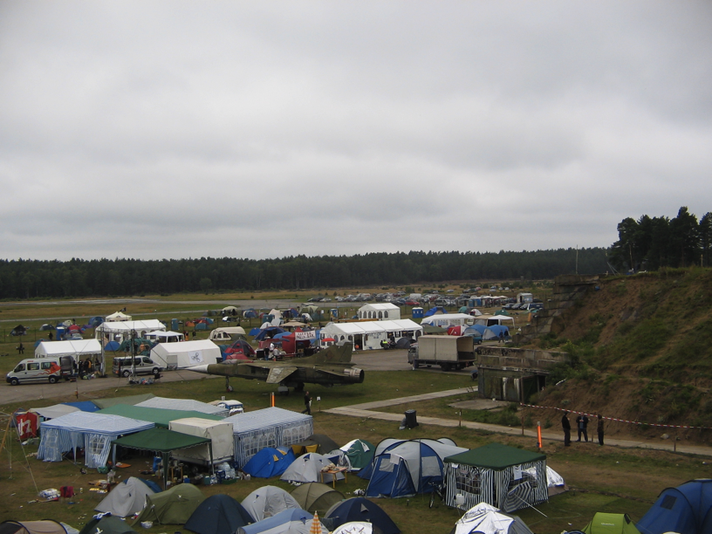
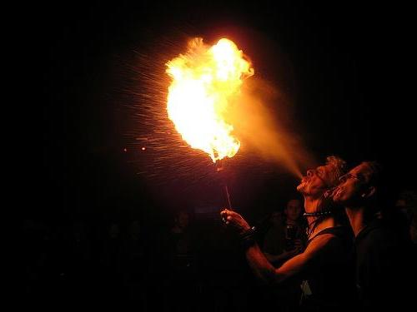
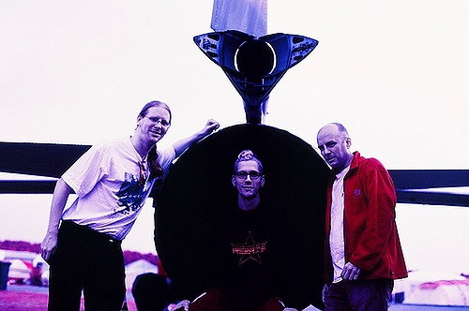

Slide 6
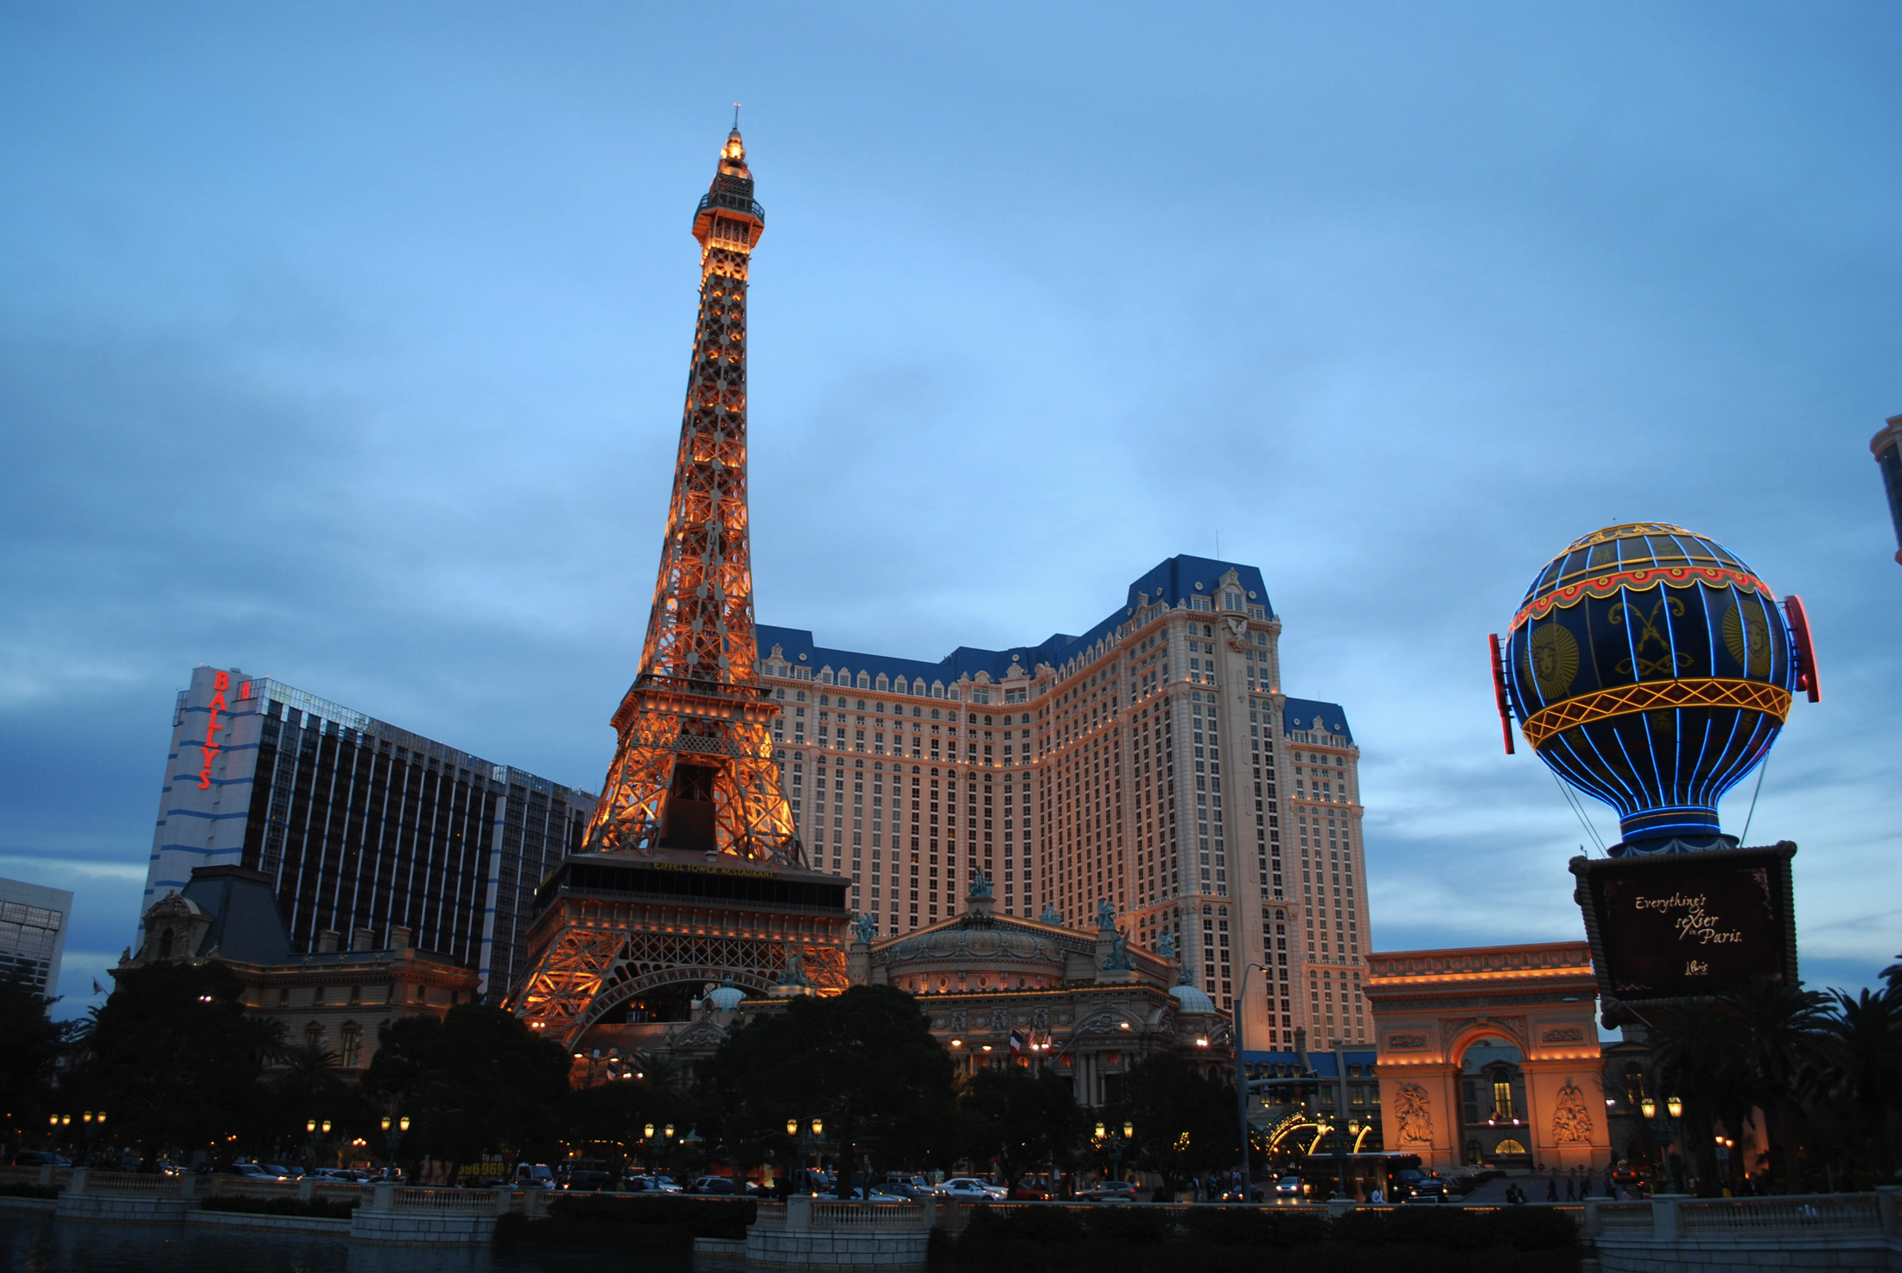




Slide 7


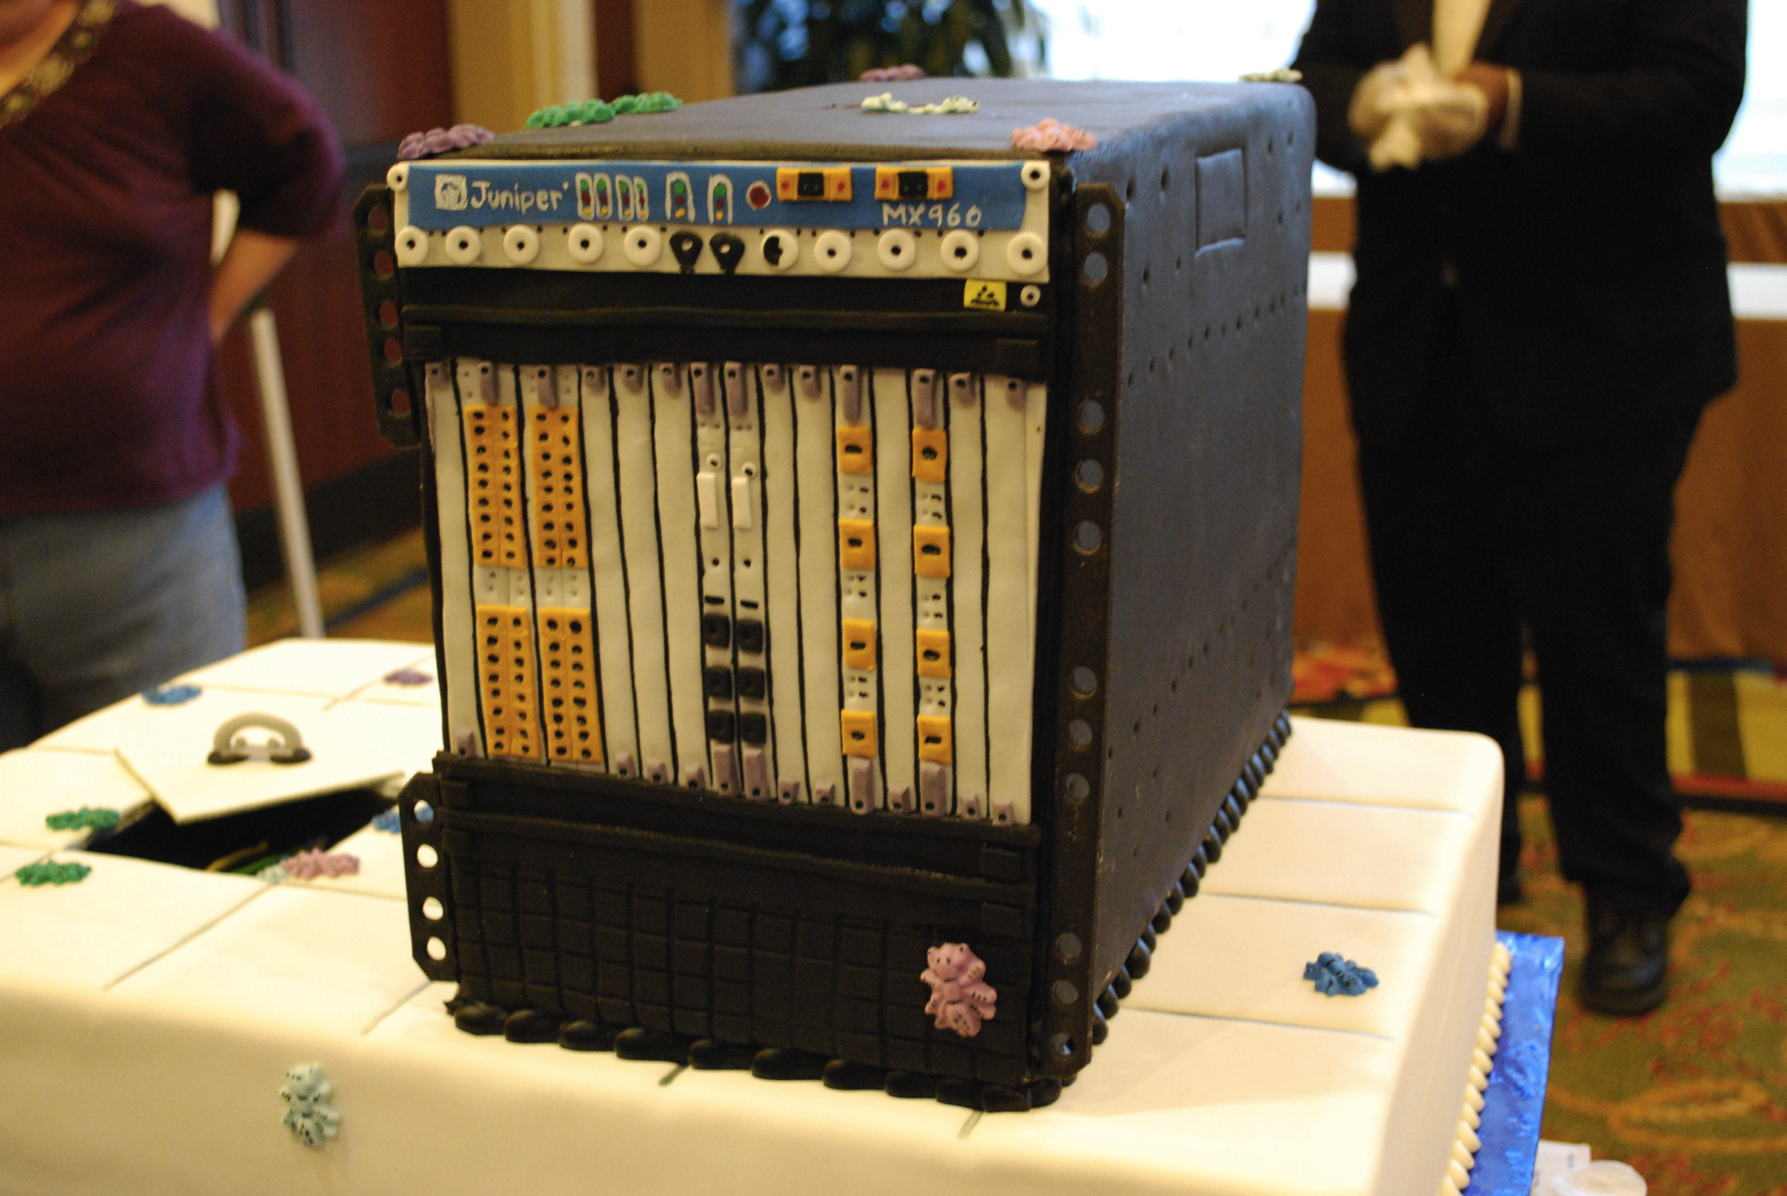



Slide 8
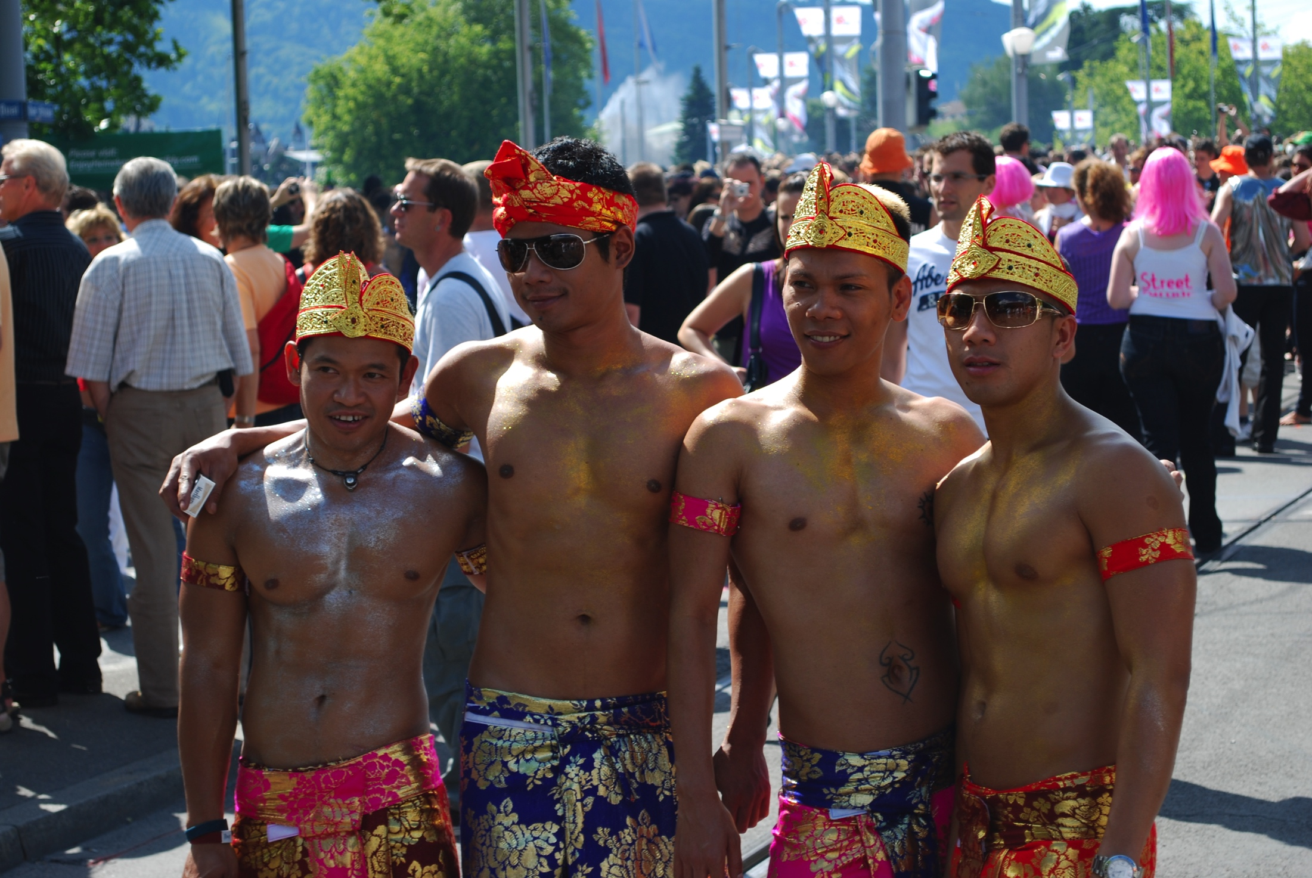




Slide 9






Slide 10
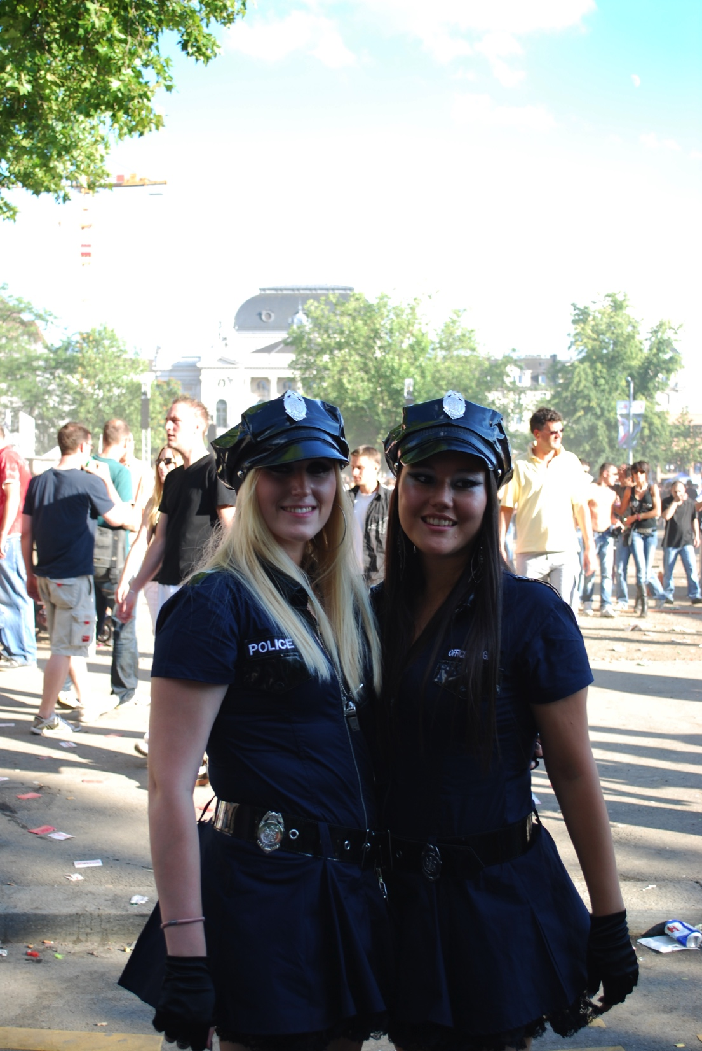

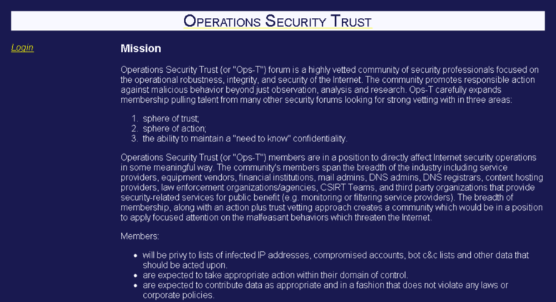
Ops-Trust

Slide 11
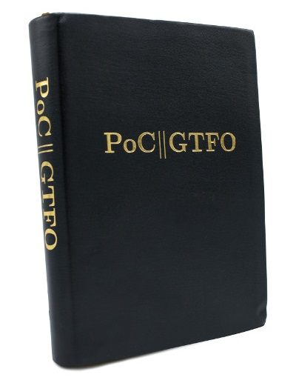

Slide 12

BSides!

Slide 13

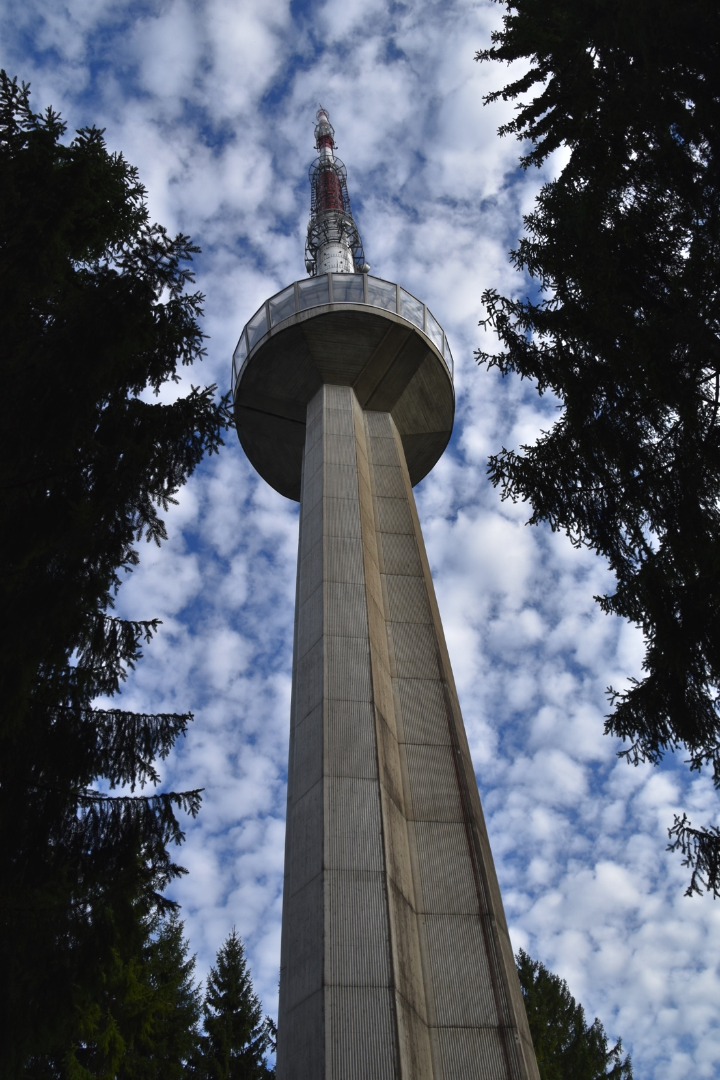


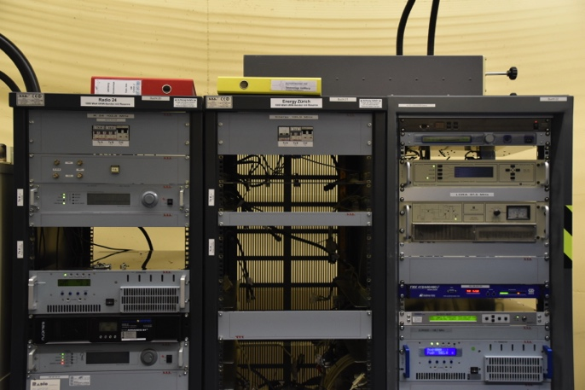

Slide 14


Slide 15
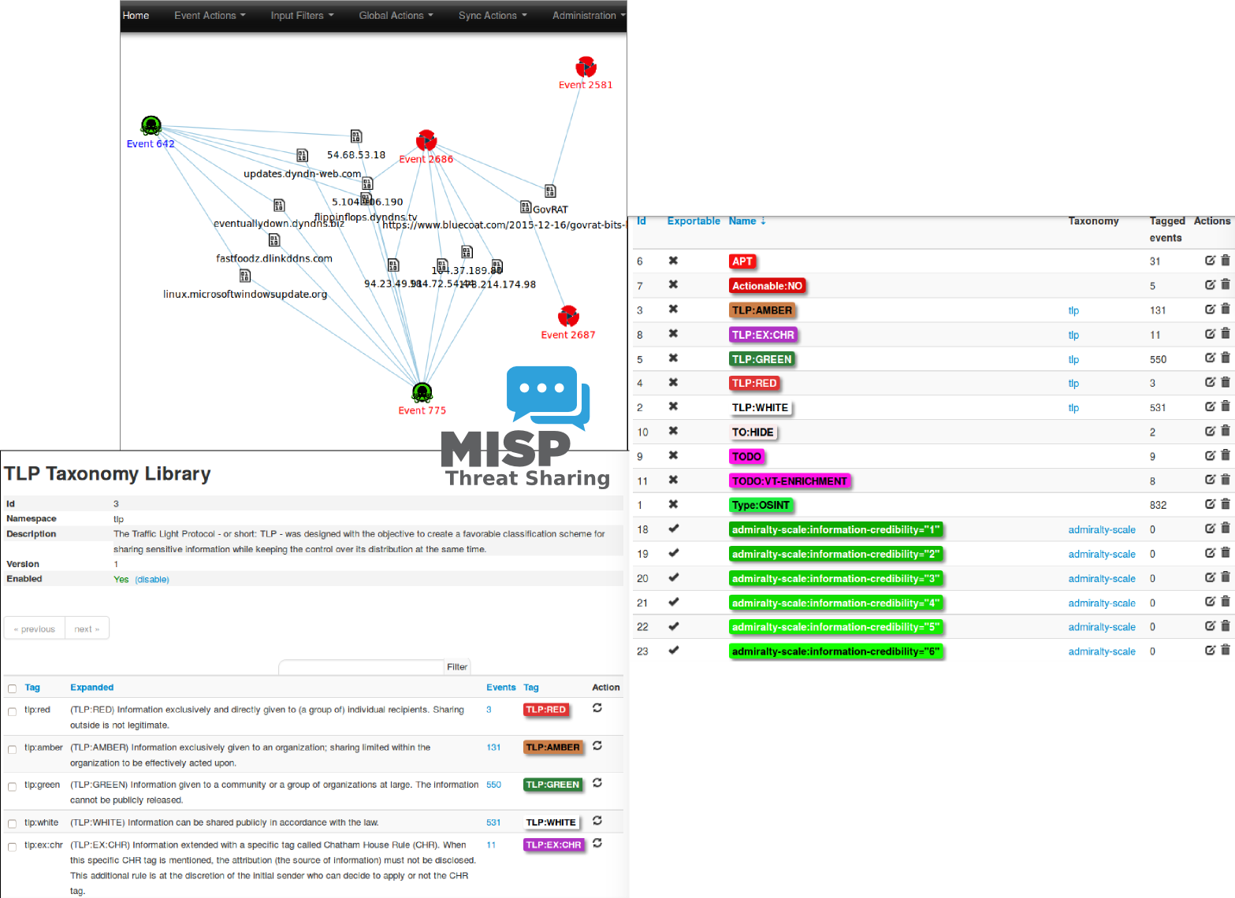
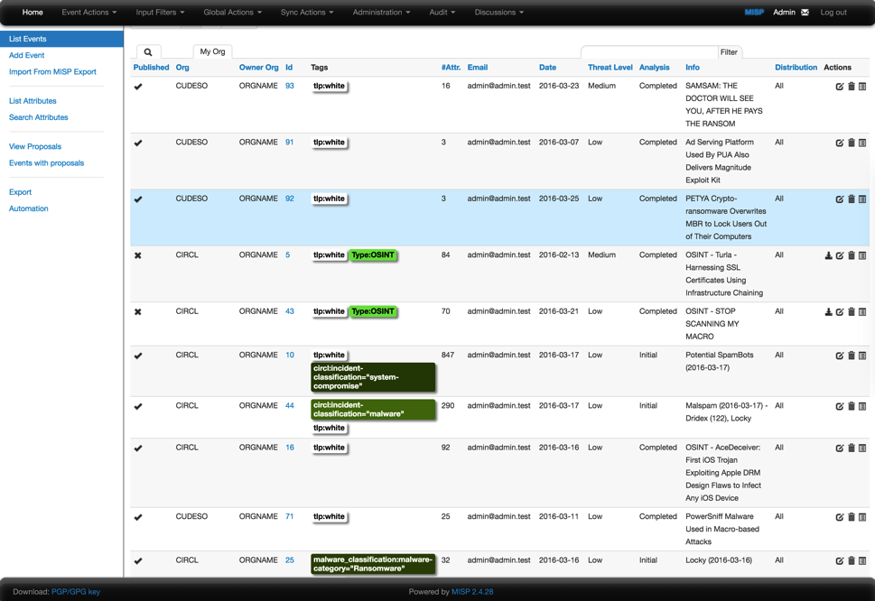

Slide 16
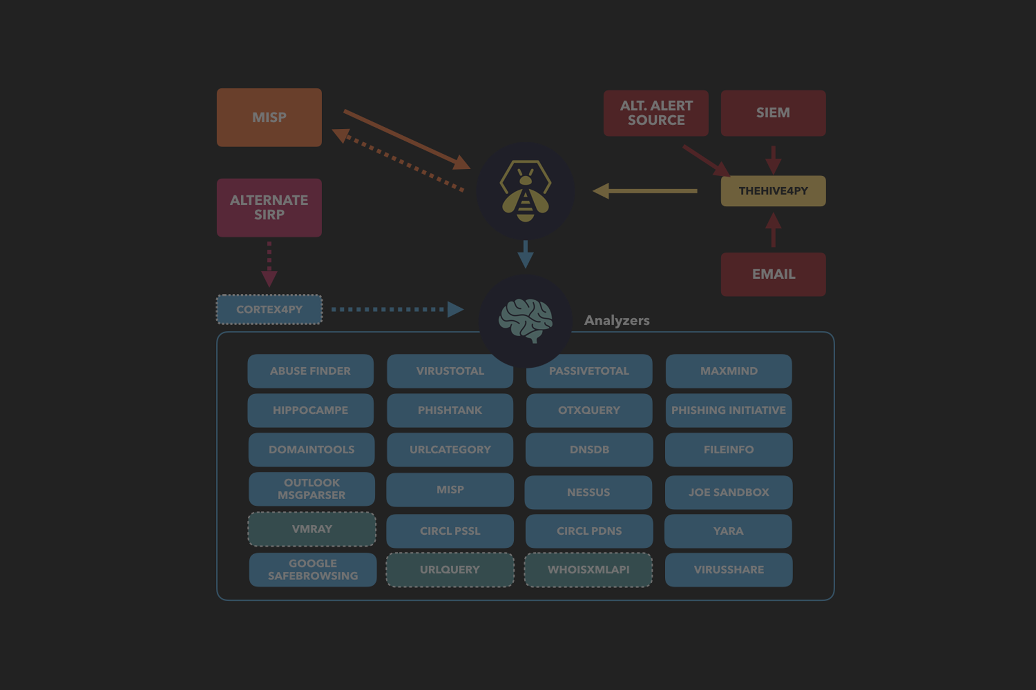
TheHive Project

Slide 17
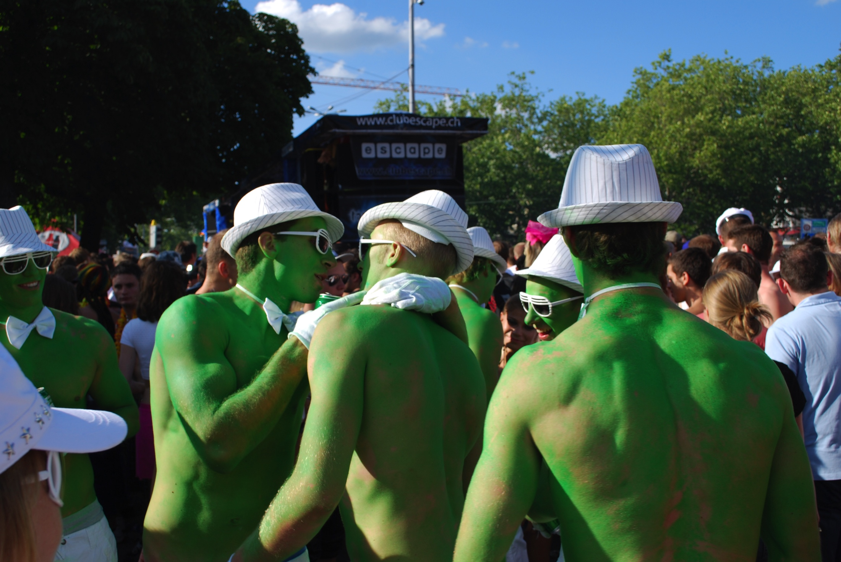

GNU Mailman

Slide 18
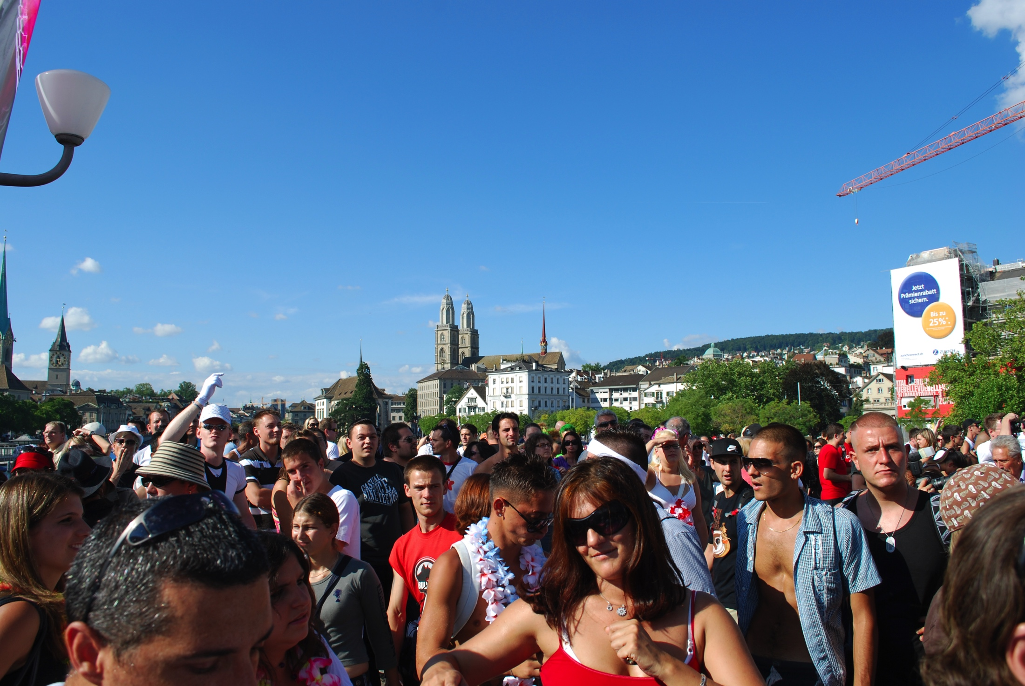

Schleuder
https://schleuder.nadir.org/

Slide 19

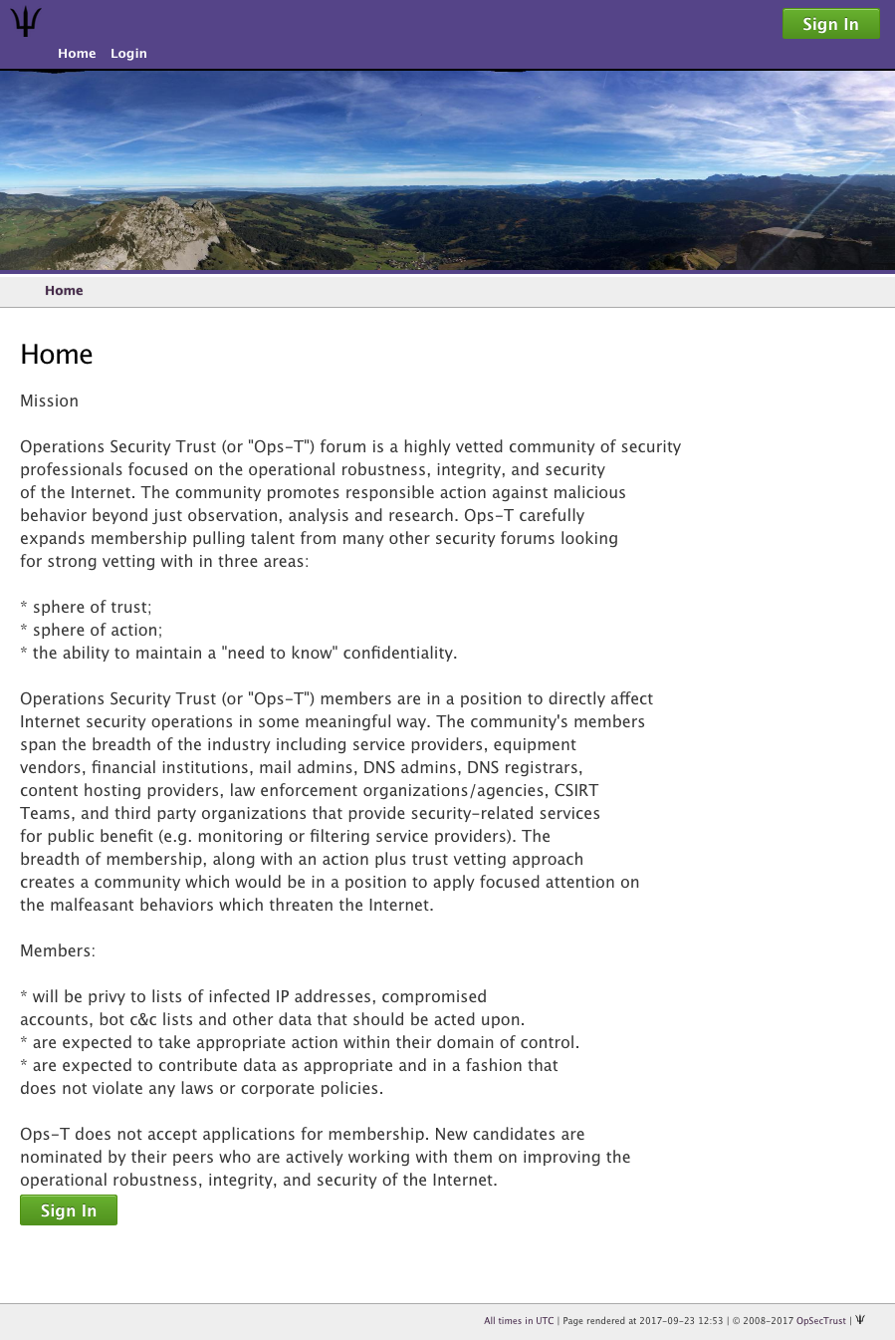
Trident

Slide 20
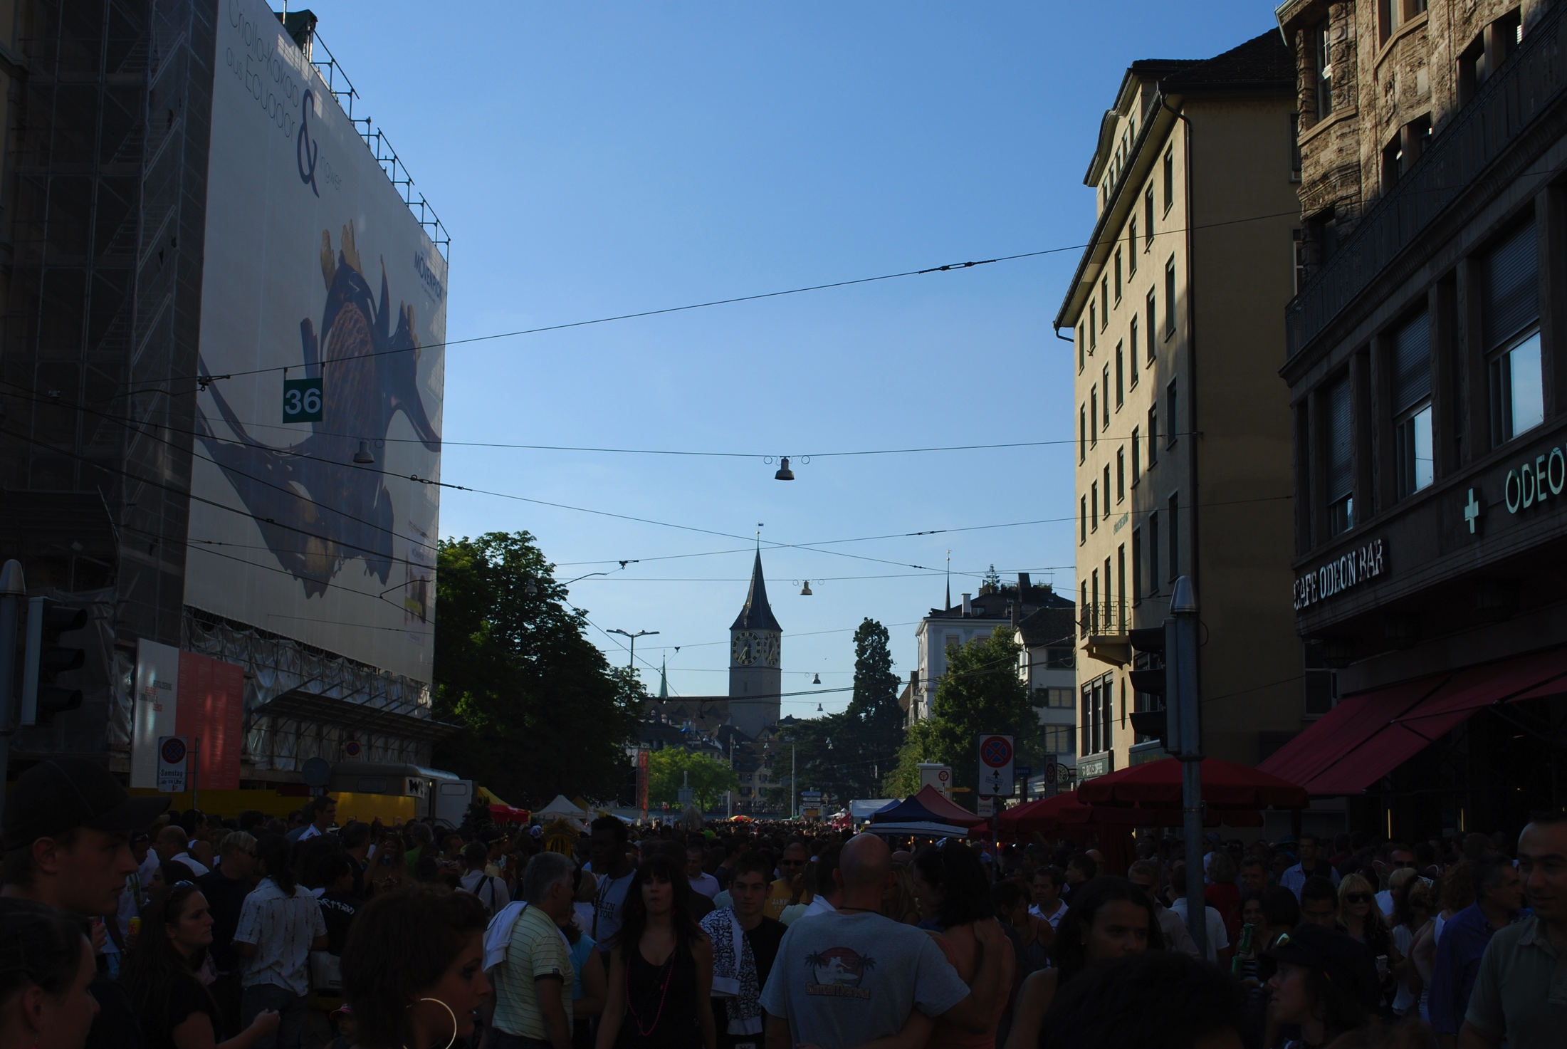
Mentoring!

Slide 21
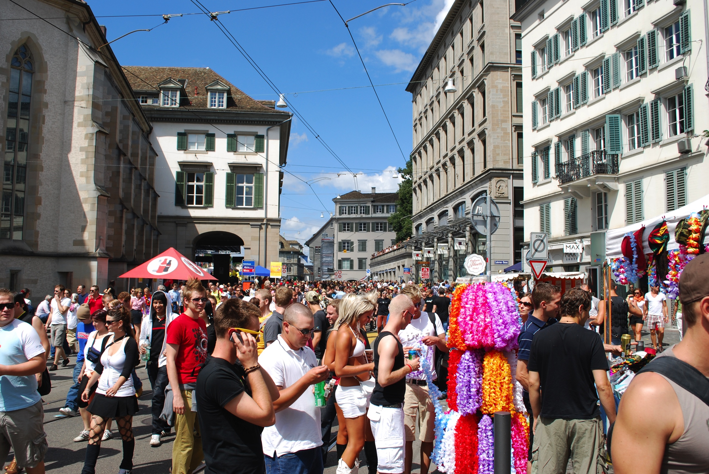
Trust?

Slide 22
Questions?
Jeroen Massar
jeroen@massar.ch
https://jeroen.massar.ch

